Slide 1
Anaconda
SURP 2020 Python Bootcamp
Ohio State Astronomy
Slides by: James W. Johnson

Slide 2

Anaconda
These really big – no seriously like really big – snakes from South America
Like 30 feet long dude
Don’t hurt people as much as the movies would suggest, but still a few meanies out there

Slide 3

Whoops Wrong Anaconda
A package manager for python
Terminal: conda
Comes with NumPy, SciPy, Matplotlib, Pandas, etc.
Even if you didn’t know about anaconda, chances are you’re already using it anyway if you’ve used these packages before

Slide 4
NumPy
Perhaps the most widely used python distribution
Contains
An N-dimensional array object
A highly optimized mathematical library (including linear algebra routines)
Fast Fourier Transforms (FFTs)
Some common functions: linspace, logspace, arange, sin/cos/tan/etc., where, genfromtxt, savetxt, argsort, isnan/isinf/isreal, zeros, histogram, linalg.X, and the list definitely goes on.

Slide 5
SciPy
Widely used throughout STEM fields
Contains
Numerical integration
Interpolation
Optimization
Linear Algebra
Statistics
Some popular functions: interpolate.X, optimize.X, integrate.X

Slide 6
Matplotlib
One of the most widely used plotting packages
Seaborn is also popular
If you’re using matplotlib as an astronomer, chances are you’re using pyplot.
Some popular functions: pyplot.plot, pyplot.scatter, pyplot.errorbar, pyplot.imshow

Slide 7
Bottom Line
You have a wealth of tools at your disposal through Anaconda.
Questions about how to use a specific function and what happens under the hood can usually be answered by its documentation.
With the number of tools available, there are many ways to write the same program.

Slide 8
Example
Problem: Randomly generate 10 (x, y) points, scatter plot them using matplotlib, and save the figure.

Slide 9
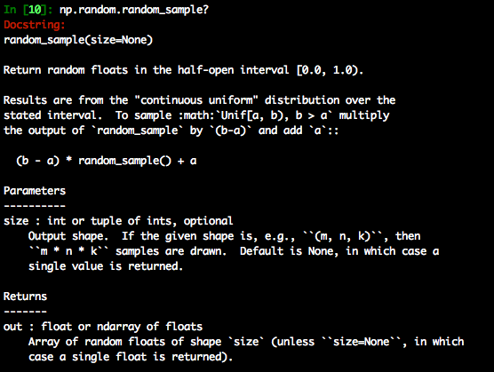
Example
Problem: Randomly generate 10 (x, y) points, scatter plot them using matplotlib, and save the figure.
numpy.random.random_sample

Slide 10
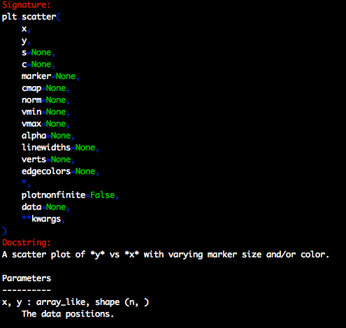
Example
Problem: Randomly generate 10 (x, y) points, scatter plot them using matplotlib, and save the figure.
numpy.random.random_sample
matplotlib.pyplot.scatter

Slide 11
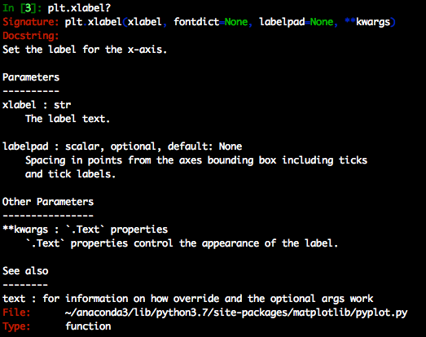
Example
Problem: Randomly generate 10 (x, y) points, scatter plot them using matplotlib, and save the figure.
numpy.random.random_sample
matplotlib.pyplot.scatter
matplotlib.pyplot.xlabel

Slide 12
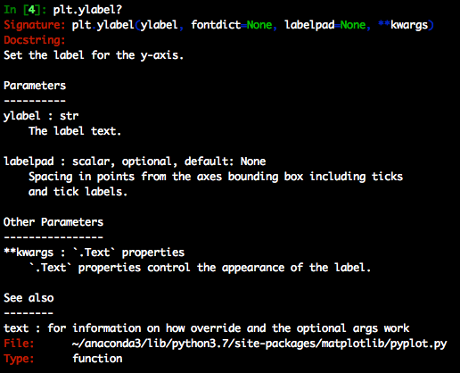
Example
Problem: Randomly generate 10 (x, y) points, scatter plot them using matplotlib, and save the figure.
numpy.random.random_sample
matplotlib.pyplot.scatter
matplotlib.pyplot.xlabel
matplotlib.pyplot.ylabel

Slide 13
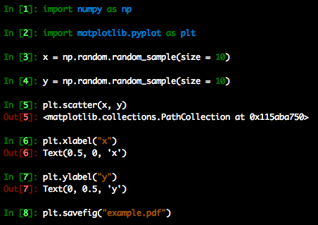
Example
Problem: Randomly generate 10 (x, y) points, scatter plot them using matplotlib, and save the figure.
numpy.random.random_sample
matplotlib.pyplot.scatter
matplotlib.pyplot.xlabel
matplotlib.pyplot.ylabel
The solution:

Slide 14
Example
Problem: Randomly generate 10 (x, y) points, scatter plot them using matplotlib, and save the figure.
numpy.random.random_sample
matplotlib.pyplot.scatter
matplotlib.pyplot.xlabel
matplotlib.pyplot.ylabel
The output:

Slide 15
Plotting: Some Useful Matplotlib Functions
pyplot.scatter
pyplot.plot
pyplot.fill_between
pyplot.errorbar
pyplot.legend
pyplot.subplots
pyplot.xlabel
pyplot.ylabel
The plotting functions in pyplot have the same signature when working with a subplot (e.g. ax.scatter, ax.plot, ax.errorbar).
Subplots are more flexible than calling pyplot directly, and can be made with:
fig = plt.figure(…)
ax = fig.add_subplot(…)
ax.set_xlabel(“x”)
ax.set_ylabel(“y”)

